Slide 1
Overview manual 2022.03.23

Slide 2
ConMas i-Reporter
Aim of the product
There are two types of documents:
Standard document (formatted fixed form such as inspection form)
Non- standard document (Drawing PDF, handwritten notes on photographs, etc.)
Currently, i-Reporter can only handle standard documents.
With i-Reporter, these two types of documents
Standard document (format fixed form)
This is to be able to handle both Non-standard documents (Drawing PDF, handwritten notes on photographs, etc.)

Slide 3
ConMas i-Reporter
With a combination of
+
With i-Reporter, you will be able to create two types of documents, standard and non-standard!
Standard document (form) → With the i-Reporter app Report / record form created on-site such as inspection report
Non-standard document → With the i-Repo FreeDraw app Notebook documents that can be freely created on site, such as corrective instructions, handwritten on PDF drawings, pasting graphics, pasting photos, etc.

Slide 4
ConMas i-Reporter
Main features of
1
A high-performance iOS / iPad OS handwriting draw app for creating non-standard documents on site.
2
You can turn blank pages, PDF drawings, PDF documents, images, and i-Reporter forms into pages.
3
Two types of pens for handwriting, graphic objects, and text input for free memos. It is possible to cut out a part from a PDF drawing, paste an image taken with a camera, and paste an image saved in a photo library. PDF drawings and PDF documents remain as vectors without any deterioration in image quality.
4
Inter-app cooperation with i-Reporter is possible. You can insert the material created by i-Repo FreeDraw as the page of i-Reporter form.
5
You can also share to cloud storage such as Box and send to Microsoft Teams, Slack, LINE, email, etc.

Slide 5
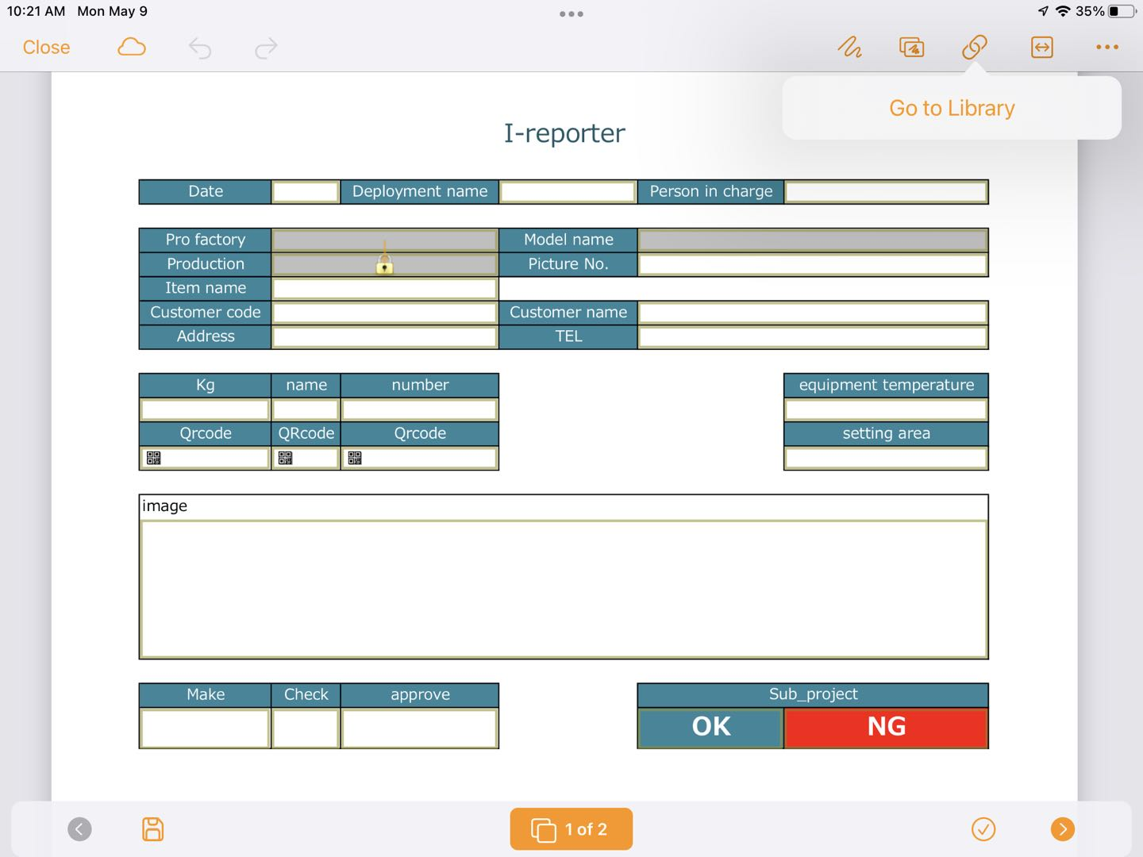
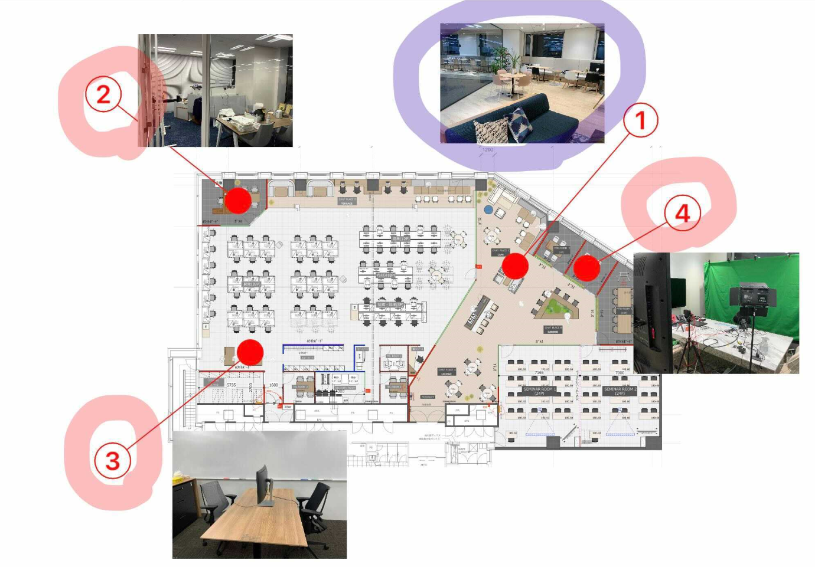
ConMas i-Reporter
Manage with ConMas server
The ConMas server manages both i-Reporter forms and i-Repo FreeDraw documents.
Save i-RepoFreeDraw documents in the ConMas server's library management.
You can refer to it as a PDF document as a related document from the i-Reporter app.

Slide 6
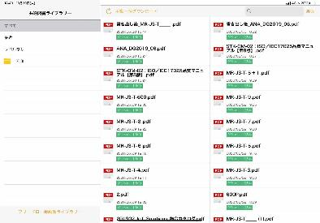
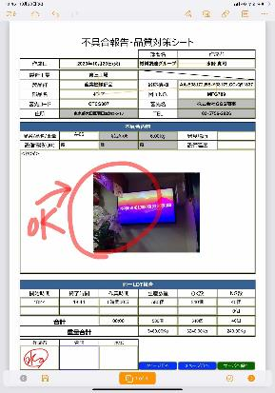
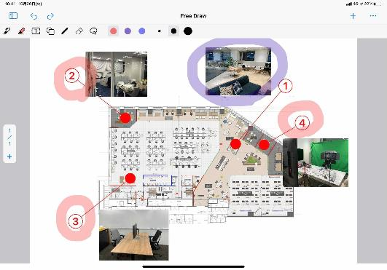
ConMas i-Reporter
+
System configuration
Cloud Service
ConMas Server
PDF Documents, PDF Drawings
Excel, Word, PowerPoint Office Documents
Image, audio, video
PostgreSQL Data Base
i-Repo FreeDraw Documents Saved in Book Library
LOGIN ID
PW
LOGIN ID
PW
Standard form document = i-Reporter document
Non-standard document = i-Repo FreeDraw document

Slide 7
ConMas i-Reporter
Main functions
Creating a new document
Blank notebook
PDF drawing
Images saved in the photo library
Image taken on the spot
Draw Tool
① Ballpoint pen
② Highlighter (highlighter)
③ Text
④ Paste graphic object
⑤ Line / balloon line
⑥ Eraser
⑦ Quoits tool

Slide 8
ConMas i-Reporter
Main functions
Pasting other documents and contents (partial cutting is also possible)
Image
Image taken on the spot
PDF drawing
User-specific stamp
i-Reporter Library Documents
Add / remove pages
Blank paper
PDF drawing
Image
Image taken on the spot
Copy page
Sort pages

