Slide 1


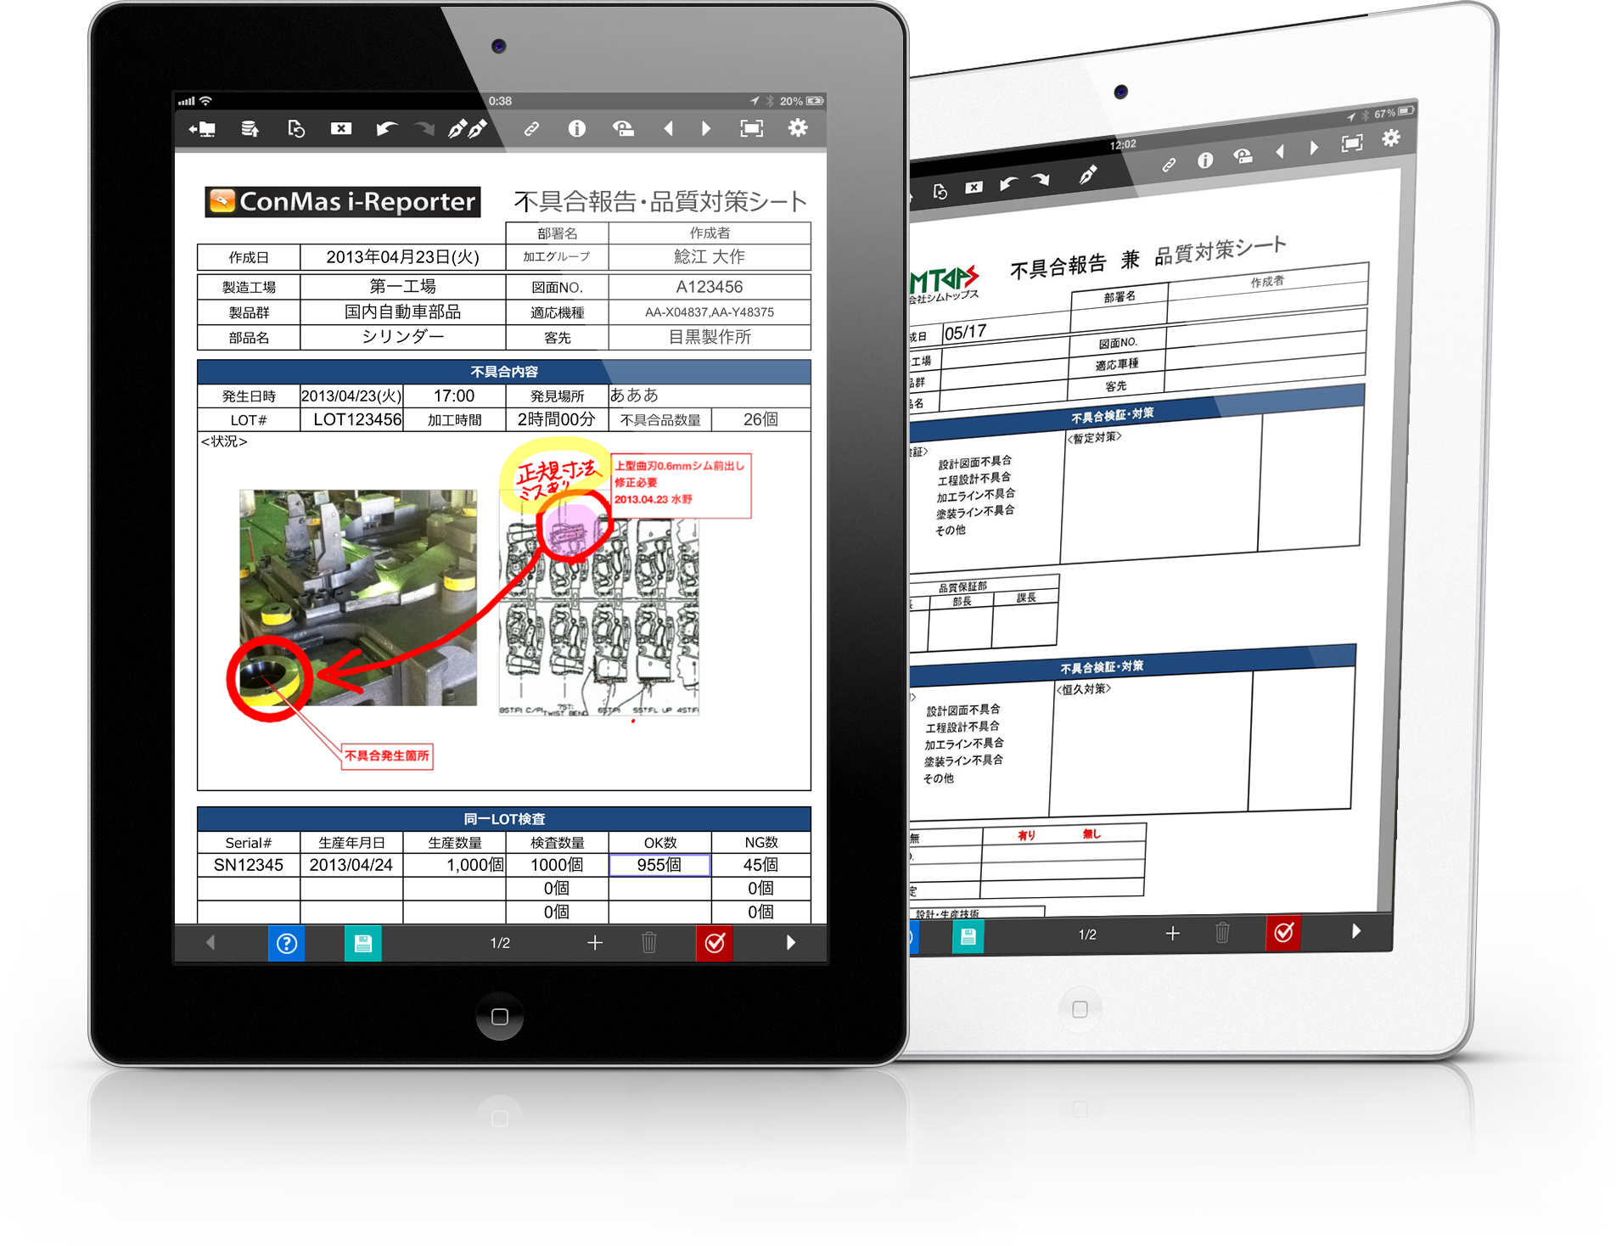
It’s not just digitalization
Problem solving ideas collection

Slide 2




【Manufacturing】
Daily Report
Result Data Collection

Slide 3
Daily Work Report
Collecting production result data

Slide 4



Professional Production
Grasping work man-hours in individual order production
【Applied work】
Man-hour management for assembling machine process
Current status
・There is a place for assembling machine tools for each order, and work is done by a team of three people. Although the manager wants to recognize the man-hours and progress of the three workers, only grasps the start and end of work time on a daily basis. The exact individual man-hours are unknown.
データの一元管理と活用で品質管理の向上！
After improvement
Three people can easily enter work results on an input document on one tablet. Progress can be checked in real time!
▽ How?
Prepare a simple form to enter the order information (product number, product name, process name, worker name etc.), work start, completion and number of exits like toilet breaks.
Three people enter the information in one input document using different pages.
Order information is entered in advance. (Use automatic document creation function).
Enter the worker name only once, then enter the start, completion of work and breaks.
By grasping the work progress and man-hours of the three people, wasted time has been visualized and it made the labor costs of the three people reduced.
Production management system
① At each work place launch i-Reporter with tablet
② Instruction contents (blue frame) are linked to i-Reporter from the management system in advance.
③ Return results to the production management system and grasp labor costs
Product no.
Product name
Worker
Worker
Process
Start
Finish
* 1 page per person, total 3 pages.

Slide 5


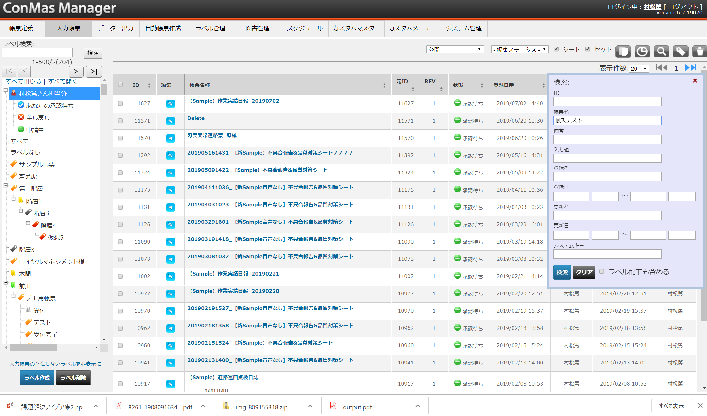





Professional Production
Prevent mistakes when checking endurance tests
【Applied work】
Endurance testing of products
Current status
・ Checking the tightening torque value before and after the endurance test (to check for looseness). The paper endurance test instruction and report sometimes does not match to the actual product.
・There are times when a normal value is determined to be abnormal and an abnormal one normal, due to the threshold of the abnormal value being misread.
・When the endurance test results are inputted to a management system, double postings frequently occur and wasteful operations increase due to the paper report.
データの一元管理と活用で品質管理の向上！
After improvement
Succeeded in improving the accuracy of reporting and that of endurance test products and reports.
▽ How?
QR codes are pasted on the product or in places where endurance testing, and the corresponding check sheet is read from a custom menu to prevent inconsistencies between the actual endurance test and check sheet.
Abnormal values are also automatically determined by the numerical cluster in each test, and the color changes or an error sign is shown. Therefore, abnormal values are easily noticed.
Endurance checkpoints can also be represented as schematics on the form, making it easy to grasp the checkpoints graphically. The entered data is automatically converted to a database by PostgreSQL.
①When reading the QR code that is attached to the product, an endurance check report is launched. Product names, endurance check items, and drawing information are entered in advance.
② At the point shown on the drawing, check and enter numerical values so that there are no mistakes. (Abnormal values change color.)
③ The checking contents are managed in the database and transfer to other system automatically. Since it is possible to search and find necessary data in DB, it is also possible to refer to the results of endurance tests of similar products.
Product name
Exam name
１：
1
２:
2
１：
２：
2
1

Slide 6



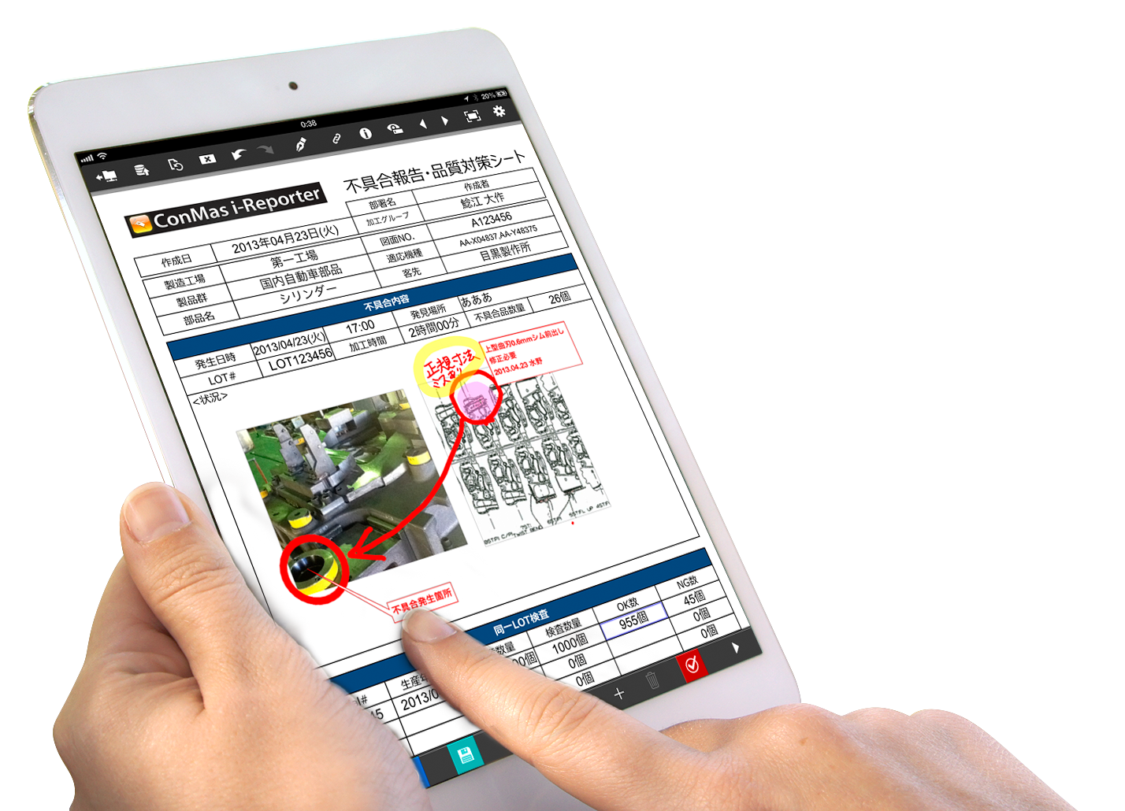

Professional Production
Streamlined teardown operations
【Applied work】
Completion of Teardown Review Form
Current status
・Issues at teardown study meetings with many suppliers.
・Teardown of collaborative products from other companies and filling in suggestions for improvement of (our) products and parts, a considerable amount of paper is generated, taking a lot of man-hours for aggregation, conversion to electronic data, and analysis.
VA提案書の記入効率化、データ化工数削減
After improvement
Proposal creation efficiency of teardown participants is markedly improved.
More improvement proposals are gathered than before, and the tabulation work becomes easier.
▽ How?
QR codes for teardown participant information obtained in advance during registration.
Documents can be drafted after development by barcode reading drafts with participant information in the code in the form.
Since the same form can be launched by quoting basic information of the participants at the same time as saving after completing the entry, details can be filled in efficiently.
Basic information on the contents of the first draft (book information, participant information, and the main part of the proposal) need not be entered for the second and subsequent sheets.
You can also use CSV to batch output data and/or link to external systems for totals after filling in.
① Advance reception
④ Read the study form just before preparation for drafting by QR linkage
Study meeting reception system
② QR code included
Participation slip printing
CIMTOPS Corporation
1111 Cimtops Taro
* The basic part of the proposal is taken over and copied. Multiple proposals can also be easily made.
③While participating at the teardown study meeting read the QR code of ② with i-Reporter on the tablet that is given
⑤ After you complete drafting, CSV data can be directly output from ConMas Server (DB: PostgreSQL) and linked to external systems.
CSV
Link to internal database
Link to business intelligence tools

Slide 7
Quality Management
Inspection
Traceability

Slide 8



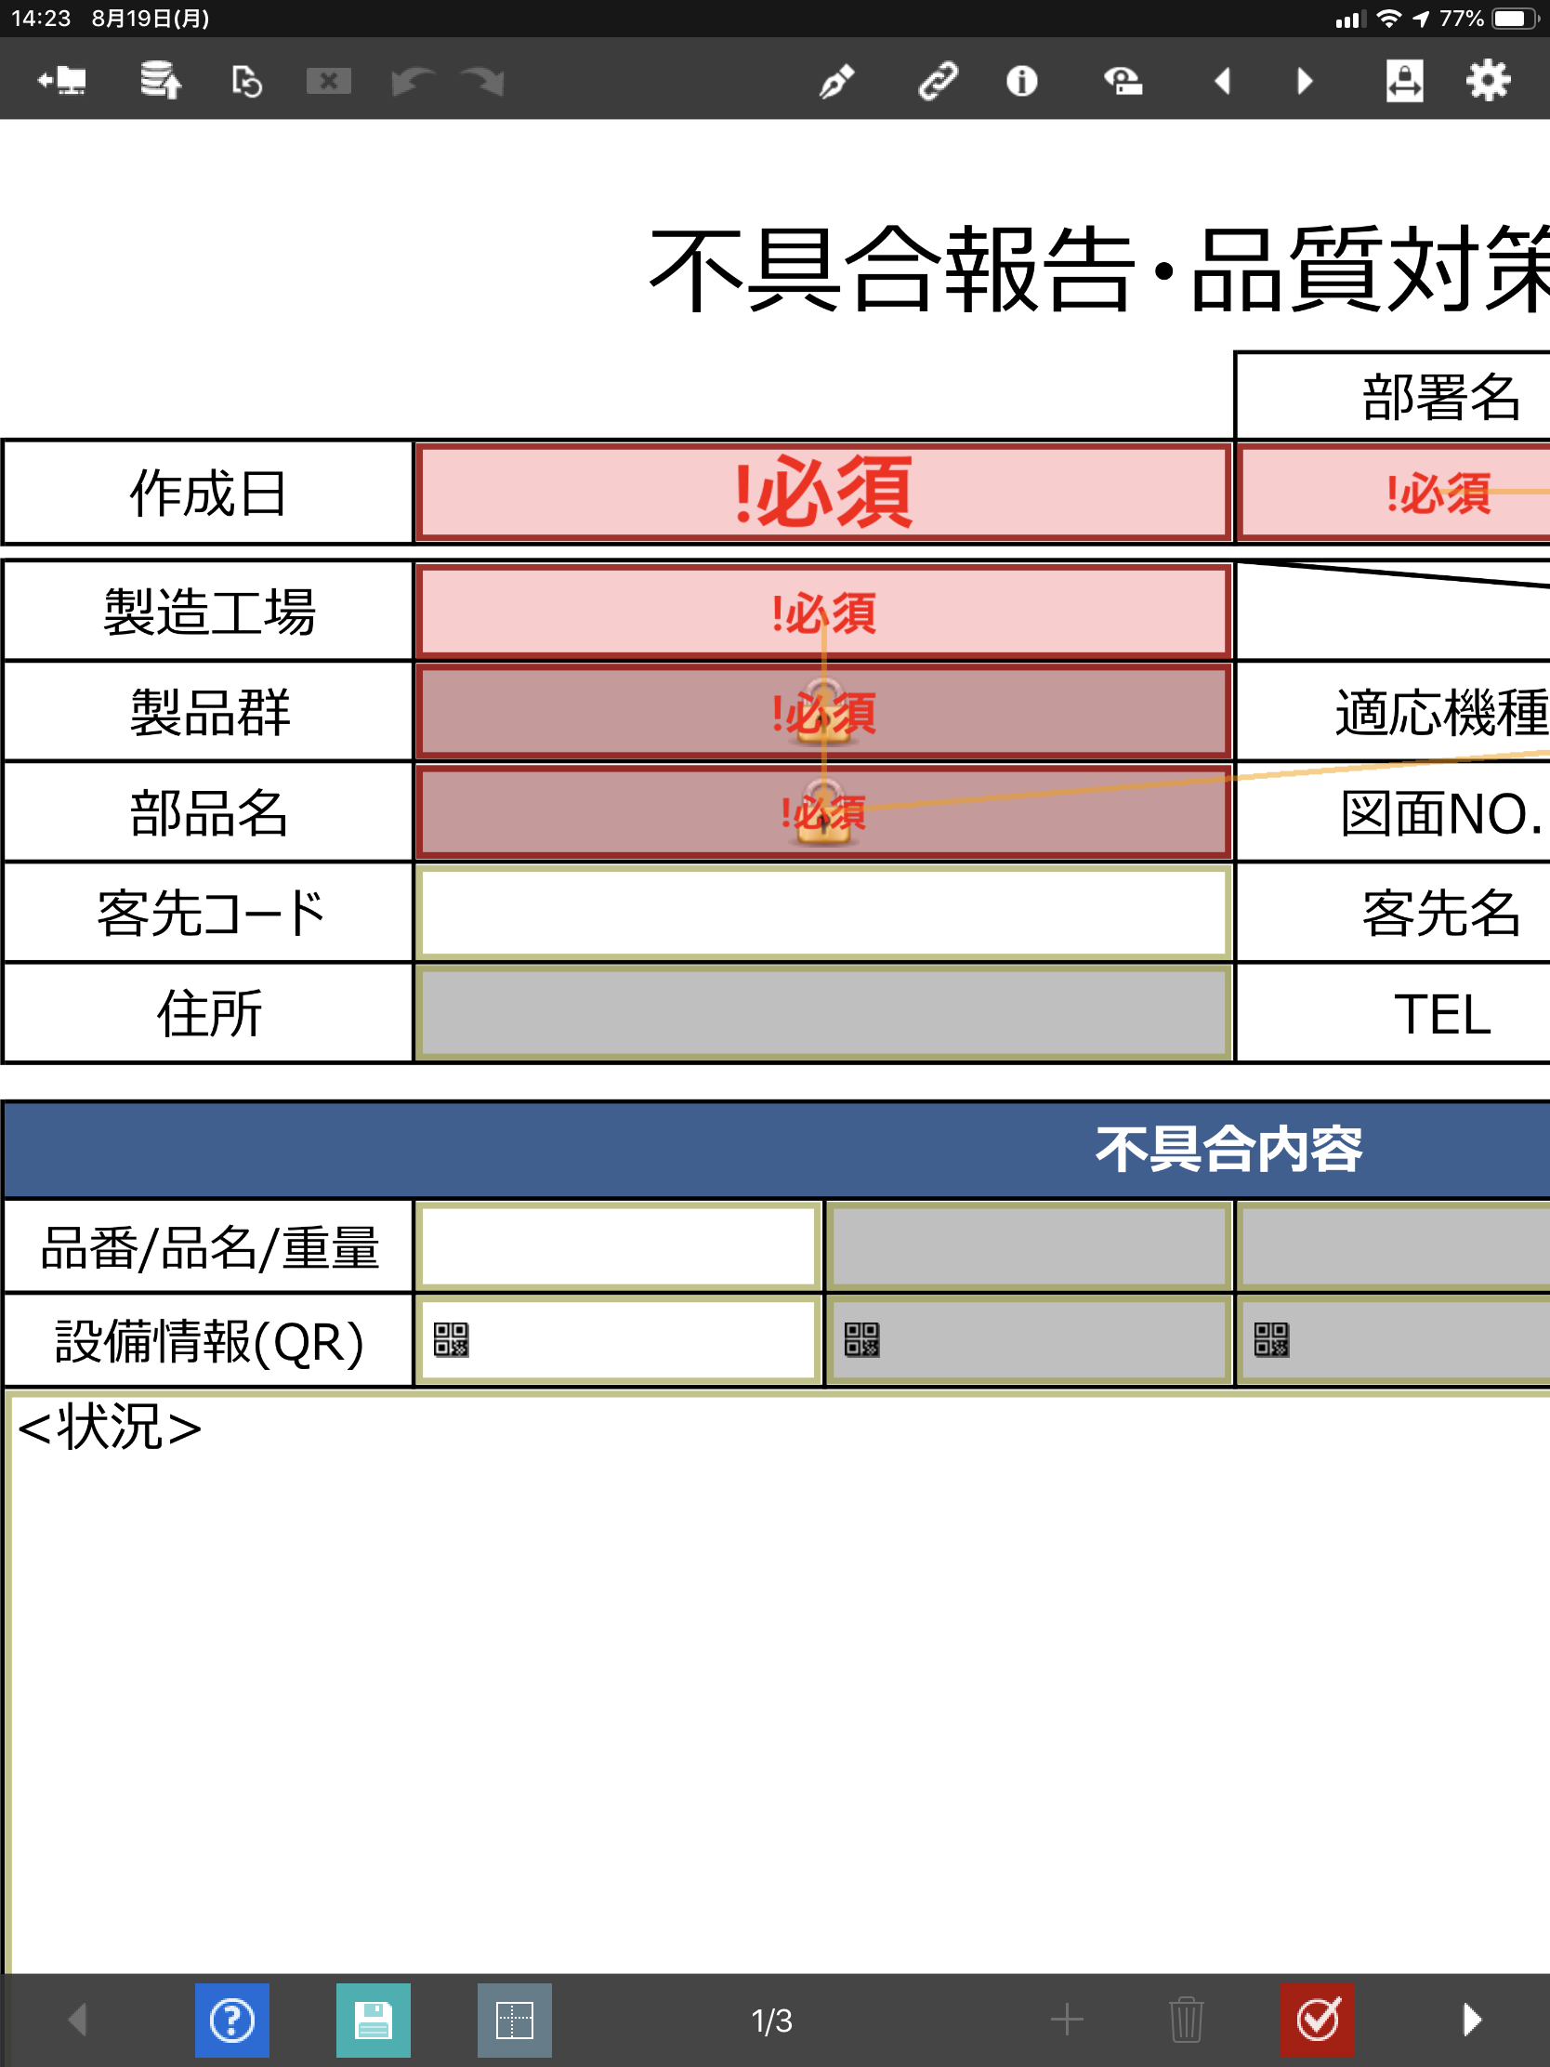







Manufacturing: Quality Inspection
Efficiency of inspection work
Current status
・Due to inspection omissions discovered after reporting, ｒe-moving and re-inspection have occurred.
・Slow to inform and take measures to parties concerned in the event of an abnormality
After improvement
・Work leakage has disappeared.
・Has become possible to immediately notify and respond to abnormalities..
◎Work leakage prevention
Cannot send to the server if not checked
Notification of abnormalities
◎Real-time sharing of anomalies
Report
Alert display for abnormal values
◎ Abnormal values
noticed on-site
◎ Quick response
i-Reporter functions to be used
＃Mandatory input/＃Numerical value cluster/＃Normal maximum/minimum value setting/＃Mail notification

Slide 9
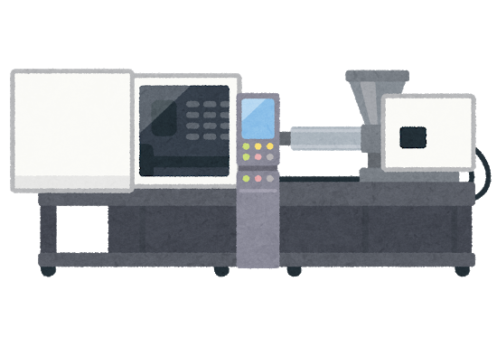
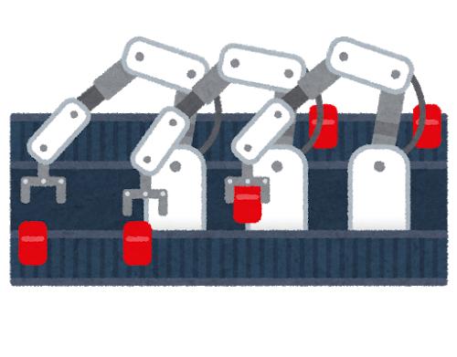
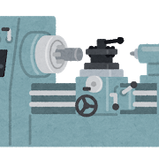






Manufacturing: Quality inspection
品
Improvement in quality control
Current status
・Some information in the quality report at the final inspection of production line has not been unified, such as part of the inputted into management system manually and part of the information re-entered into EXCEL.
・When there is progress confirmation from another base or customer, need to look for a paper file or a record in the folder server to search for the past information , it takes a huge amount of man-hours.
・Revision history of the contents in the report is not managed.
After improvement
・All report data is centrally managed in a database. Necessary report data can be searched immediately, and can be output in various file formats such as PDF, Excel, CSV.
・Information in the database can be automatically linked with the management system, etc., and thus man-hours for transcription can be reduced to zero. (* Requires external collaboration development)
・The revision history of a form can also be checked at a glance (when, where and who has rewritten what).
Each quality inspection process
Process A
Process B
Process C
Report
Core system
Database
◎Improved searchability
◎Can output report data in various data
formats
◎Revision history can be checked
◎Centralized management of
all report data
◎In cooperation with an external systems, etc., data transfer
man-hours can be reduced
i-Reporter function to be used
#ConMas Manager / # Automatic file output / # External system linkage API

Slide 10



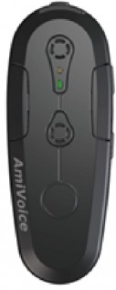
Manufacturing: Quality inspection
Voice input for inspection measurements
Current status
・Two man-hours are required for measurement and report entry.
(One person reads out the measurement value and the other person fills out the report form)
・Changing the measuring instrument and report form is a hassle.
・In environments where it is difficult to fill in paper reports (closed, dark, high places, etc.), there is a time
lag from visual observation to filling in measured values, and errors occur.
After improvement
・By simply reading out the measurement results, they can be entered immediately in a designated place in the report.
・Man-hours for a clerk are not required.
・Hands-free work is possible without having to hold a report.
Measured value 45mm
Measurement value is set
Measured value
45mm
厚み
45㎜
Audio input mic
Correctness of the voice input
value can be confirmed by answerback
Other things possible to do:
・Customer can also enter with own words
・When you ask "Where is it now?" it tells you the name of the item that was entered most recently
・Input setting by abbreviation is also possible
◎ Hands-free form entry is possible
◎ No need to fill out reports
i-Reporter functions to be used
#Voice input

Slide 11

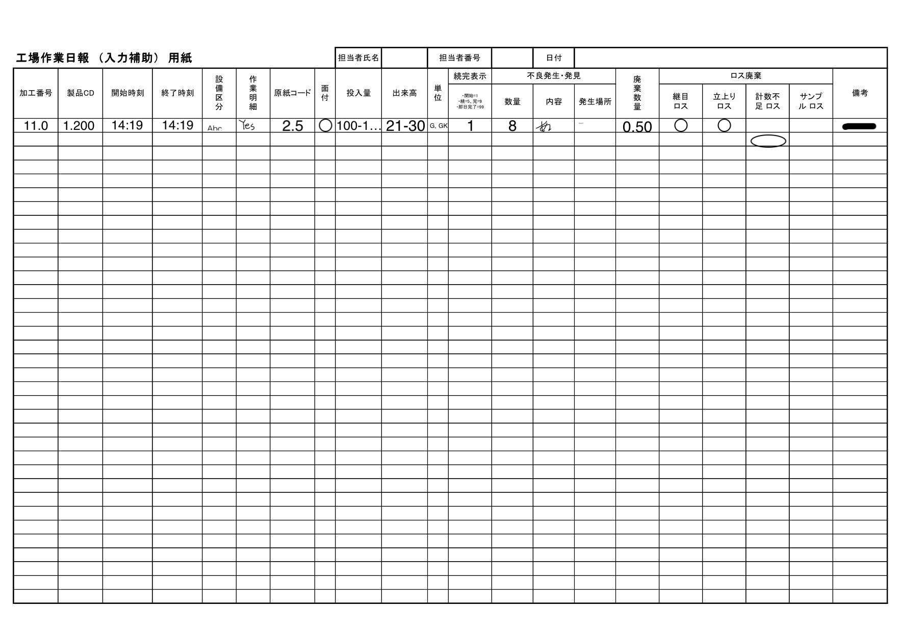


Manufacturing: Quality inspection
Immediate start of check sheet input
Current status
・There are so many product numbers that it is difficult to find a target check sheet.
・Finding a check sheet in progress of that of another person in charge takes time.
現品所在地のリアルタイム把握
After improvement
・Necessary check sheet for work can be started on tablet immediately.
Get information in barcode
(Order information: product number, etc.)
Search
Work instructions
◎Necessary check sheet is
opened immediately
Template form
Check sheet in process
i-Reporter functions to be used
＃Custom menu

Slide 12




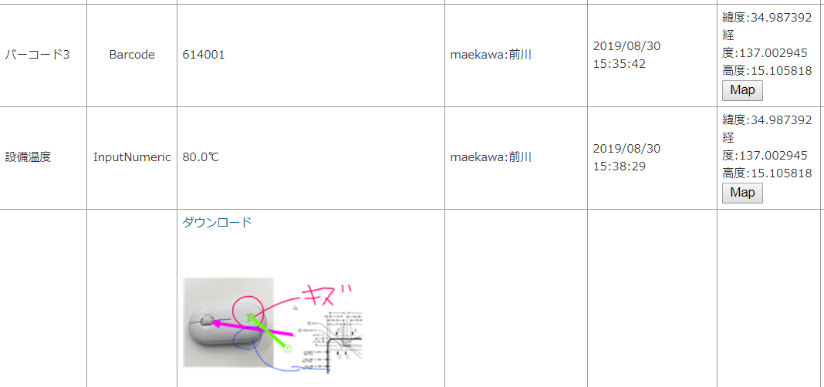
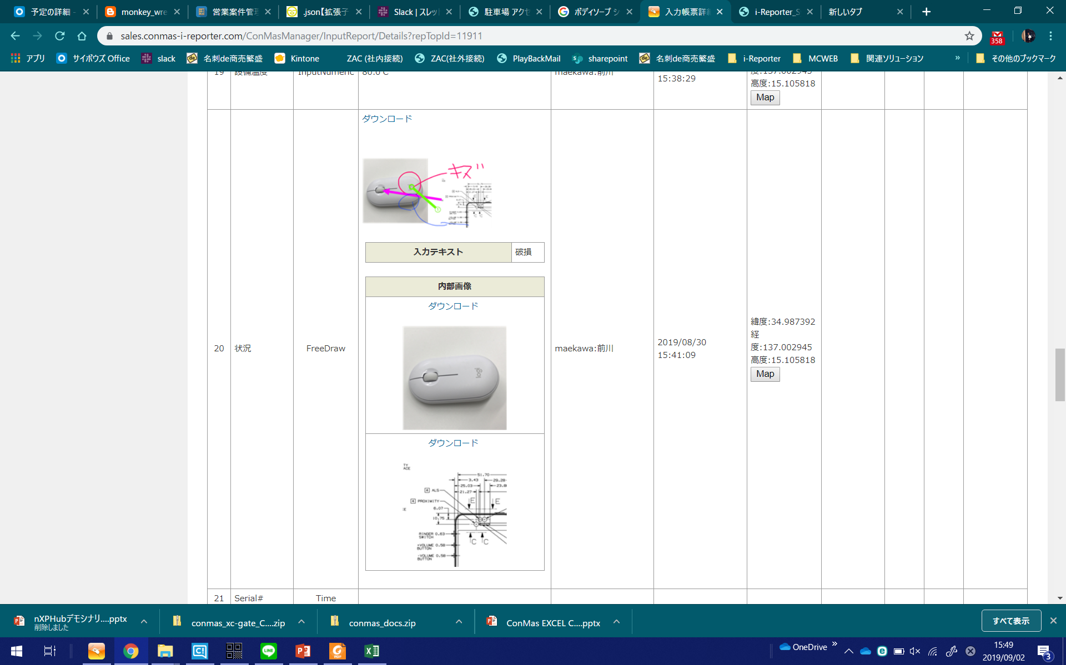
Maintenance/Maintenance Business
Traceability improvement
Current status
・Do not know if the right work is done at the right time and place.
・Do not know if the customer's signature after a repair is really done by the
customer.
・Do not know if reported photos were really taken at that site.
現品所在地のリアルタイム把握
After improvement
・Has become possible to take logs and manage "when and where and who wrote" for each item.
・Has become possible to see if customer signatures and report photos were entered and taken at the site.
Automatic recording of each input
Report
How
what
Who
When
Where
◎Tampering can
be managed
i-Reporter functions to be used
＃ConMas Manger/ # Image cluster / # Create cluster

Slide 13

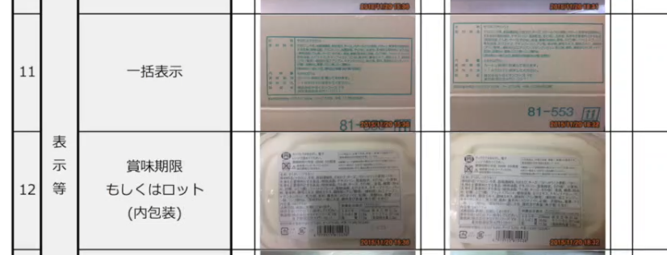

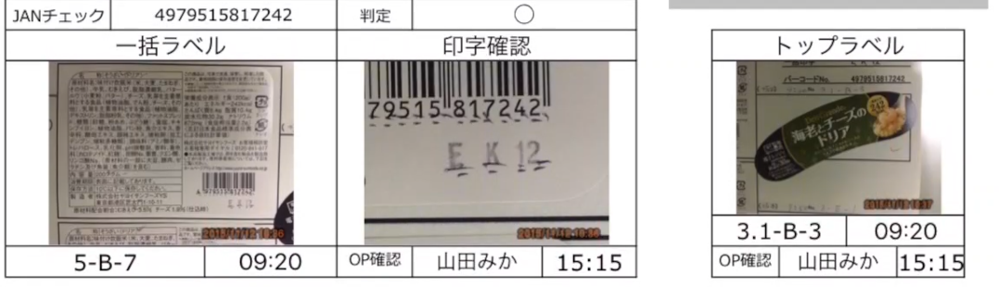
Manufacturing: Quality Inspection
Efficient food quality inspection
Current status
・The person in charge reads the label and fills in the confirmation results by hand.
Not many items are able to be checked.
現品所在地のリアルタイム把握
After improvement
・Improving the reliability of evidence by directly taking photos of label stickers attached to food items to forms and read the barcode to match the data.
(Photo) shooting label stickers
Paste label sticker photos
directly into forms
i-Reporter function to use
# Paste photo

Slide 14
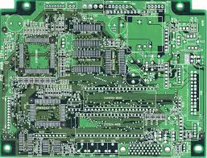
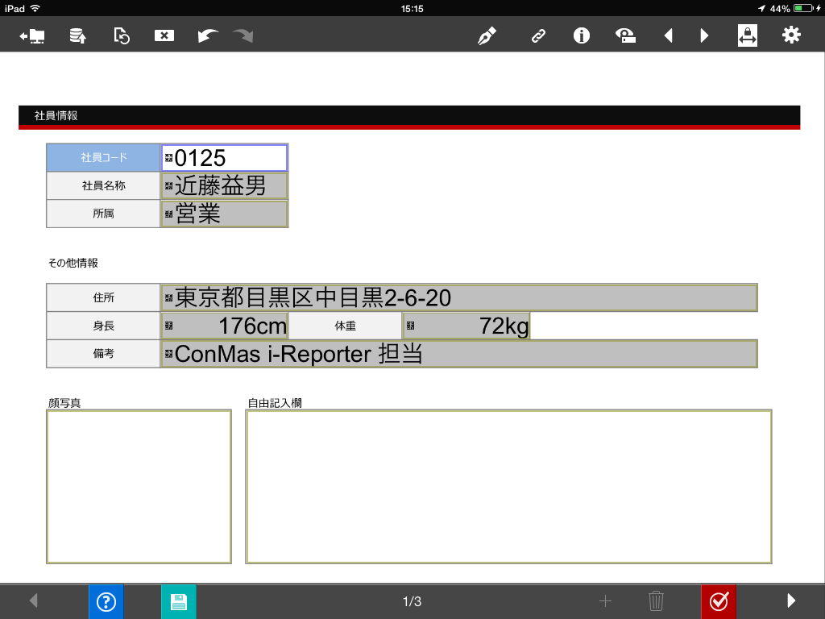
Manufacturing Industry: Maintenance Inspection
Efficient inspection work on mixed flow lines
Current status
・ Since inspection items are different for each model because of the inspection in a mixed operation line of more than 30 models, a lot of inspection time was required.
After improvement
・A QR code is affixed to the work and a special inspection sheet is initiated in one shot by reading the QR code.
・Information such as machine number, model and date of introduction is extracted from the contents of the QR code and automatically set in the report.
QR code attached to the workpiece
is read
QR code data is disassembled and automatically entered at once to start a form
0111245896,CT12345,AAA基板,BBBユニット,AX00012345,2015/05/25,DDD-21345
Find an
inspection form
dedicated to that
model from over
30 types
Information is obtained by disassembling the QR code, which is then input to multiple clusters.
i-Reporter function to use
#Custom menu #QR decomposition

Slide 15
Inventory control
Entry / Exit management
Inventory management

Slide 16

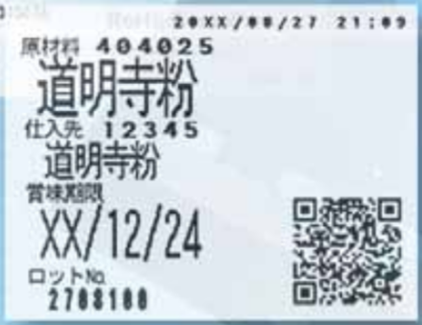

入出庫管理の効率化
Real-time grasp of actual inventory
Current status
・As warehousing and inventory numbers are entered by hand on paper inventory slips and transferred to the production management systems, a lot of posting of man-hours occur.
・Actual inventory does not match the inventory on the form due to omissions or mistakes.
・It takes time and effort to double check entries to prevent mistakes and work time increases.
現品所在地のリアルタイム把握
After improvement
・Manually entered posting work into the system is no longer required.
・Became able to reduce the time for handwriting on paper and calculating numbers for inventory.
・Real inventory is able to be grasped in real time, which has led to efficient purchase operations.
Warehousing processing
Inventory System
Delivery processing
External linkage
External linkage
Item code QR reading
Start delivery instruction
External linkage
Report
Report
Enter the number of goods receipt
Picking and entering
◎Reduction in man-hour postings
◎Prevention of omission errors
◎Prevention of misalignment between forms and actual stock
i-Reporter function to use
# Barcode cluster / # Calculation cluster / # Custom menu

Slide 17

入出庫管理の効率化
Efficient warehouse management
Current status
・ Cannot confirm if there are no mistakes when taking out materials.
・ Handy terminal costs and program development costs are enormous.
After improvement
現品所在地のリアルタイム把握
・ Receipt information labels can be issued immediately upon receipt.
・ Picking mistakes can be prevented.
・ Handy terminal purchase costs and program development costs can be eliminated.
Enter material information received
QR code issuance from label printer based on warehousing information
Paste QR code on raw material
Keep raw materials on shelves
Compare Picking list and raw material QR codes when leaving.
i-Reporter function to use
◎Prevent picking mistakes
# Action cluster: URL link function

Slide 18
Operating instructions
Process progress management

Slide 19

Manufacturing Industry
Operating instructions
Current status
・Operating instructions are ambiguous and the worker makes a mistake to use
a machine equipment.
現品所在地のリアルタイム把握
After improvement
・If the machine equipment is different, the report cannot be entered.
Work has come to be done in the equipment correctly according to instructions.
Work order confirmation & barcode verification
Machine to be planed to use
◎Prevent mistakes to choose machine equipment.
i-Reporter function to be used
# Barcode cluster / # Calculation cluster / # Automatic report creation

Slide 20




Manufacturing Industry
Process progress management
Current status
・The location of work in process cannot be grasped in real time.
・Telephone each person in charge of a process or directly go to the site for confirmation, and confirmation takes time.
After improvement
・The location of work-in-progress can be ascertained simply by looking into the
folder (label) for each process.
・When the work moves to the next step, because the report is also automatically
moved to the folder (label) of the next operation name, no sorting effort is required.
Enter work process
Completed
report
Automatic sorting
Process A
Automatic movement
Process B
◎Realtime knowing the location of
work in process
&
◎Reduction of sorting effort
Process C
i-Reporter function to be used
# Auto label

Slide 21
Equipment Maintenance
TPM

Slide 22





Manufacturing industry: Maintenance/Maintenance
Improving to grasp information of abnormal blade tool
Current status
・Want to collect trend data on blade failure and use it for design, but it has not been converted into electronic data.
・Blade inventory may be exhausted due to the next day's report.
・It is difficult to confirm by e-mail or phone whether there are any report omissions.
現品所在地のリアルタイム把握
After improvement
・Abnormal blade tool information can be shared in real time between production engineering department and manufacturing department.
・It is now possible to collect information such as the machine number, cutting tool part number, quantity, reasons for abnormality.
・Exchange cycle information can also be used for predictive maintenance in combination with other information in the future.
Notification waiting for report approval
Production
Department
Production Engineering Dep't
Cutting tool part no.
Process name
Poor accuracy！
Burr
Diameter failure
Broken!
OP mistake
Exchange cycle
Procurement of blades!
Big data
Paperless
Enter the abnormal blade status
Order
Timing
management
Cutting tool failure occurs
i-Reporter function to use
#Check cluster / # Approval cluster

Slide 23
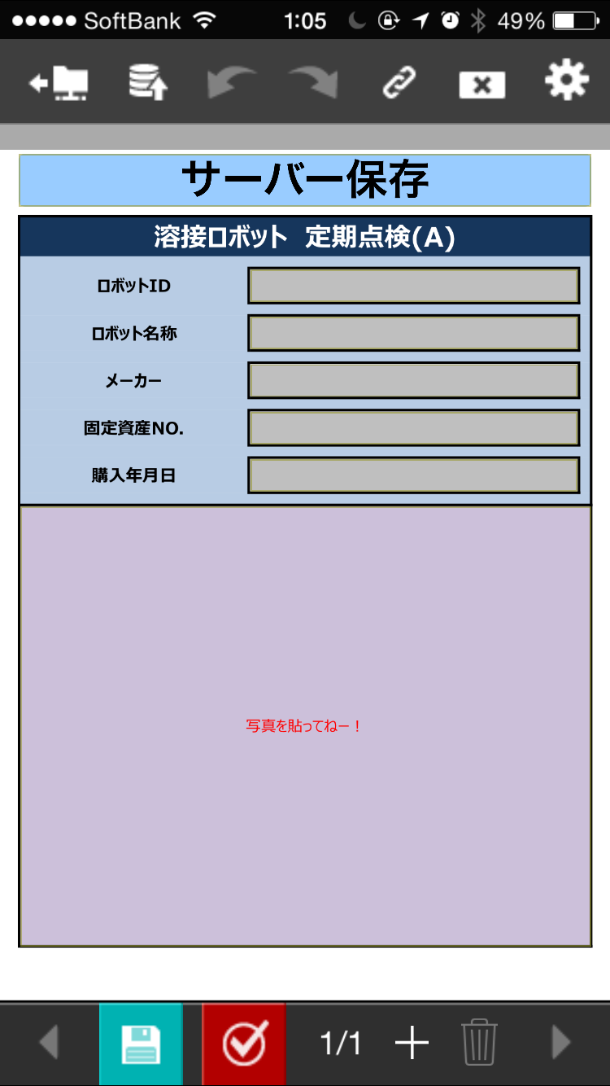
Manufacturing Industry: Maintenance Inspection
Efficient machine inspection work
Current status
・ It is difficult to find a dedicated inspection form because there are many types of
machine equipment to be inspected.
・ The number of machinery and equipment to be inspected is large, and the
inspections take time.
After improvement
・ A QR code is affixed to each machine and a special inspection form is opened on
tablet by reading the QR code.
・ Information such as machine number, model, date of introduction, etc. is extracted
from the contents of the QR code and automatically set in the report.
Read the QR code attached to
equipment
Check the model check sheet
Enter the necessary data and
start drafting immediately
0111245896
AAAA
XXX製作所
Search
2013YAEW4789
2013/11/23
Obtain information from QR code
(Equipment number, model, date of introduction, etc.)
Maintenance
inspection form for
the model is automatically
downloaded
i-Reporter function to use
# Custom menu # QR decomposition

Slide 24
Defect Management
Repair Work Management

Slide 25

Manufacturing Industry: Assembly Process
Real-time defect reporting
Current status
・ It takes time due to the person in charge of the previous process moving to the site only for confirmation when a problem occurs.
現品所在地のリアルタイム把握
After improvement
・The number of man-hours required for confirmation of defects has been reduced.
・Occurrence of defects understood in real time and prompt action taken.
Person in charge of previous process
Assembly process
Enter details of defect and take a photo of the actual product
E-mail notification also possible
Administration
Report
◎Defect status can be checked in real time
i-Reporter function to use
# Image cluster / # Free draw cluster / # Email notification

Slide 26
Maintenance / Inspection
Field service

Slide 27

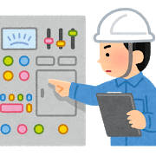





Maintenance / Maintenance Business
More efficient after-sales service
Current status
・It takes a long time to fill out reports by hand.
・Since several photos are taken per case, it takes time to determine which photo is taken when
several visits are made.
・Cannot see the progress of maintenance and repair work for each area, and person in charge.
現品所在地のリアルタイム把握
After improvement
・Report work including photo is completed on site, eliminating the need for post-processing.
・Visualization of work progress has been realized.
・The number of local work man-hours has been reduced.
◎ Work efficiency
The reports necessary on the day are obvious at a glance.
Automatic input of basic equipment information from code
External
system
Work instruction info
&
Schedule info
Report
Output
Form data
Automatic folder division for each progress
Related technical documents and schedules, no camera required
◎Baggage reduction
◎No post-processing man-hours
required for photo data
◎Simplification of
aggregation work
◎Utilize report information
On-going
Claim
Complete
◎Visualization of work
progress
i-Reporter function to use
# Barcode cluster / # Automatic label / # Automatic form creation / # Image cluster / # Schedule function

Slide 28
Operation Management
Equipment Data Collection
Daily Report Management

Slide 29

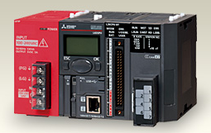


Manufacturing: Daily Report
Importing PLC information into daily work reports
Current status
・PLC information is handwritten into daily work reports every hour.
・Incomplete entry or incorrect entry of numerical values occurs.
現品所在地のリアルタイム把握
After improvement
・(Past) PLC results are directly imported into the daily work report,
eliminating omissions and mistakes in entering numerical values.
・Data analysis accuracy is improved by collecting data together with
information that can only be entered by workers.
Obtained from PLC and completed automatically
Filled in by the operator
100 230 20 34
i-Reporter function to use
＃ConMas IoT Gateway PLC linkage # Action cluster

Slide 30
Visualization of On-site Information
Data Analysis
Other Business

Slide 31




Real-time detection and analysis for abnormal
Current status
・It takes a long time summarize data to be analyzed after collecting data on site.
・Until finishing analysis and countermeasure, production needs to keep going with unknown
problems.
現品所在地のリアルタイム把握
After improvement
・Became to detect an abnormality quickly.
・Since data past 24 hours are summarized automatically, KPI to investigate the cause can be shown in real-time.
BI Tool linkage
Enter the result data of production
Error indication
Large display
Today’s abnormality
2 units
Report
KPI analysis is shown in real-time
◎Quick detection
and action
◎Analysis and action to prevent recurrence cycle
i-Reporter function to use
＃External system linkage/＃BI Tool

Slide 32

Maintenance Inspection/Maintenance Business

Slide 33
Maintenance Inspection Report Preparation

Slide 34
Architecture / Construction, General Contractor
Plant Construction

Slide 35

Logistics/Distribution

Slide 36






Retail Business
Report sharing between stores, more efficient aggregation
Current status
・Man-hours for daily sales reports collected from many stores have occurred
・Sales (data) cannot be shared among multiple stores
現品所在地のリアルタイム把握
After improvement
・There is no longer manual entry from the daily paper reports to the EXCEL table.
・Sales (data) can be shared at each site (between stores).
Daily sales report
Store
HQ
◎Can be shared between each site
Store
Daily sales report
Output
Various sales data
Store
Daily sales report
Aggregated CSV, form PDF, etc.
i-Reporter function to use
# Automatic label / # Calculation cluster / # Data output function

Slide 37


Distribution Industry
Aggregate vehicle inspection check sheets
Current status
・Total number of man-hours for vehicle inspection check sheets generated during
pre-departure inspections and periodic inspections is large. (Including text and
photo posting)
・Slow to notice omissions.
現品所在地のリアルタイム把握
After improvement
・Significant reduction in man-hours for posting from paper form to EXCEL table
・Uninspected vehicles can be quickly grasped and followed up.
◎Output aggregate data
◎ Confirmation of uninspected vehicles
Vehicle inspection form
i-Reporter function to use
# Image cluster / # Data output / # Auto label

Slide 38





流通業Distribution Industry
Efficiency of vanning and devanning operations
Current status
・When loading and unloading at the time of import / export, the actual product
inspections are done with paper form and cameras.
・ Man-hours of post-processing such as text transfer and photo occurs a lot.
現品所在地のリアルタイム把握
After improvement
・Photos taken on site can be inserted to the report soon and completed.
・The date and time can be recorded along with image acquisition as evidence.
・The B / L number (barcode) of the package can be read to determine whether it is
correct or not. If you make a mistake, you can stop working.
・A list of import management tables can also be output.
Complete photo report on site
Correct / incorrect judgment with instruction information
◎Work suppression is possible when incorrect
Instruction information
◎ Can output list
Report
◎Reduction of post-processing
man-hours
i-Reporter function to use
# Image cluster / # Data output / # Calculation cluster / # Barcode cluster

Slide 39
IT/Information

Slide 40

Service / Retail / Distribution

Slide 41
QSC Management
Quality
Service
Cleanliness

Slide 42

Retail Business
Real-time sharing of hygiene management checks
Current status
・ Check sheet of the hygiene management before and after work is paper sheet.
・ Reporting with images such as photos is not possible because it takes time.
現品所在地のリアルタイム把握
After improvement
・The hygiene management status of each store can be grasped in real
time.
・Site reports including photos can be made quickly.
Hygiene management form
Store
◎Implementation status can be
grasped immediately
HQ
Store
Store
Quick follow-up is possible
i-Reporter function to use
# Image cluster / # Approval function / # Automatic label

Slide 43
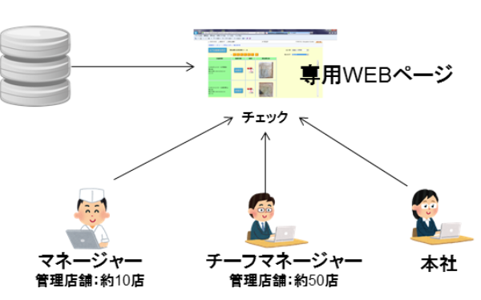



Restaurant Chain （Multi-store）
Digitization of QSC checks
QSC（Quality, Service, Cleanliness）
Current situation
・Scanning QSC check sheets on paper forms and collecting emails took time, making
it difficult to grasp the on-site situation at headquarters, making management
poorer, and reducing store QSC levels.
・Reporting with images such as photos is not possible because it takes time.
現品所在地のリアルタイム把握
After improvement
・From reporting using paper reports, PDF conversion and email, reporting using
i-Reporter with images has reduced approximately 2,400 hours per year in report
times for all stores.
・Swift automatic collection of QSC check results at stores allows managers and
headquarters to properly manage and grasp the corrective feedback necessary.
WEB Page
UDON
Manager
Managing 10 stores
Chief Manager managing
50 stores
HQ
Quick follow-up is possible
i-Reporter function to use
# Image cluster / # Approval function / # Automatic label

Slide 44
Medical / Welfare / Education

Slide 45

Improving on-campus facility management work efficiency
Current situation
・A large amount of posting effort occurs during form entry in inspections of Article
12 of the Building Law.
・Creating and sharing reports during a disaster took time, causing delays in repair
work.
現品所在地のリアルタイム把握
After improvement
・Large man-hours for filling out reports, taking pictures and pasting have been
reduced.
・No need to transfer to official reports, sharing and reporting speeds have increased.
Attach photos on the spot
◎ Immediate confirmation of reports
Inspection/Report
Report
Form data
Output
◎Official reports creation man-hours reduction
i-Reporter function to use
＃Image cluster/＃Approval cluster/＃Automatic label

Slide 46

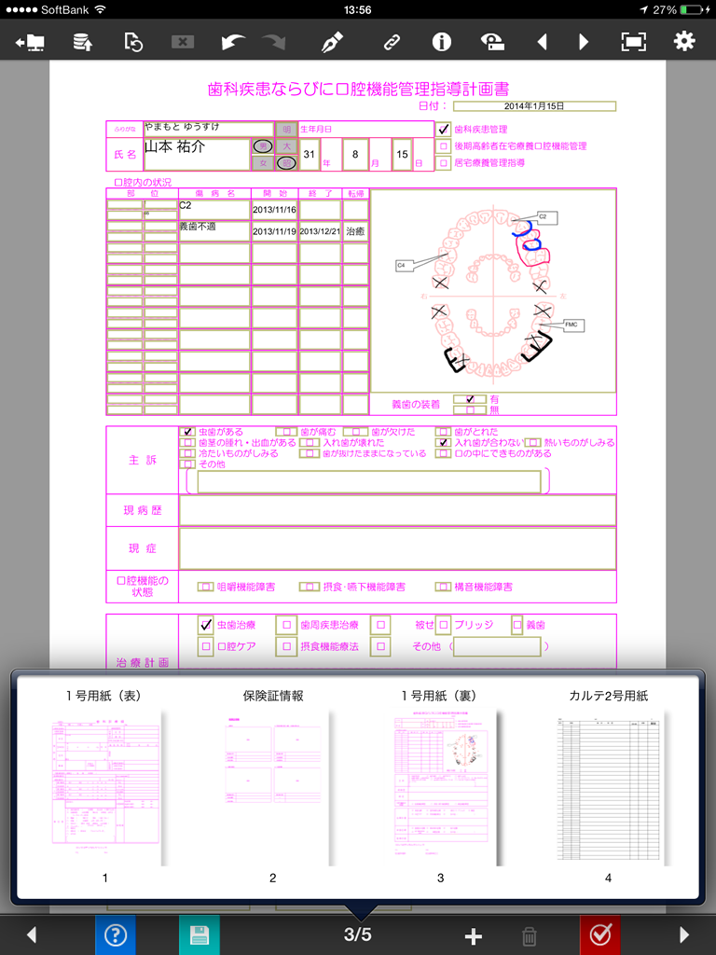
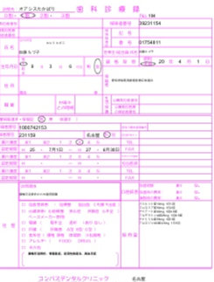






Records and medical records creation for visiting dental practice
Current situation
・There is a risk of taking personal information when bringing a patient's paper chart.
・How to fill in charts varies depending on the doctor. It’s difficult to standardize the accuracy of medical
treatment.
・If there are omissions, medical requests cannot be made and reconfirmation took time.
・During an emergency response, the patient's medical records are not at hand and cannot be shared with
the doctor in charge.
現品所在地のリアルタイム把握
After improvement
・Since medical records stored on the server can be searched quickly from the destination,
information can be shared and there is no risk of taking the information out.
・A large number of necessary items in multiple documents can be quickly filled out, without
mistakes or omissions.
・Reports including photos and oral diagrams can be realized on iPad, and a paper chart
immediately transplanted.
Dental/medical records
Fill in chart using iPad
View past medical records
◎ Email report to family
Database

